Slide 1
Constants & Enumerations

Slide 2
Constants
In programming, the term constant refers to names representing values that don’t change during a program’s execution.
Just like variables, programming constants consist of two things: a name and an associated value.
The name will clearly describe what the constant is all about. The value is the concrete expression of the constant itself.

Slide 3
Constants
The value associated with a given constant can be of any data type. So, you can define integer constants, floating-point constants, character constants, string constants, and more.

Slide 4
Constants
After you’ve defined a constant, it’ll only allow you to perform a single operation on it. You can only access the constant’s value but not change it over time. This is different from a variable, which allows you to access its value, but also reassign it.

Slide 5
Examples of Constants in Daily Life
The speed of light
The number of minutes in an hour,
The name of a project’s root folder.

Slide 6
Why Use Constants
In most programming languages, constants protect you from accidentally changing their values.
Improved readability
Clear communication of intent
Better maintainability
Reduced debugging needs

Slide 7
Constants in Python
To have a constant in Python, you need to define a variable that never changes and stick to that behavior by avoiding assignment operations on the variable itself.
You should write the name in capital letters with underscores separating words

Slide 8
User Defined Python Constants
PI = 3.14
MAX_SPEED = 300
DEFAULT_COLOR = “green"
WIDTH = 20
API_TOKEN = "593086396372"
BASE_URL = "https://api.example.com" DEFAULT_TIMEOUT = 5
ALLOWED_BUILTINS = ("sum", "max", "min", "abs")

Slide 9
Constant Names
Be of any length
Consist of uppercase letters (A–Z)
Include digits (0–9) but not as their first character
Use underscore characters (_) to separate words or as their first character

Slide 10
Replacing Magic Numbers for Readability
def compute_net_salary(hours):
return hours * 35 * (1 - (0.04 + 0.1))

Slide 11
Replacing Magic Numbers for Readability
HOURLY_SALARY = 35
SOCIAL_SECURITY_TAX_RATE = 0.04 FEDERAL_TAX_RATE = 0.10
def compute_net_salary(hours):
return (
hours *
HOURLY_SALARY
* (1 - (SOCIAL_SECURITY_TAX_RATE +FEDERAL_TAX_RATE))
)

Slide 12
Class Task
Create a Circle class and calculate area, perimeter and projected volume.
Area= pi*R2
Perimeter=2*pi*R
Volume=4/3*pi∗R3

Slide 13
Replacing Magic Numbers for Readability
class Circle:
def __init__(self, radius):
self.radius = radius
def area(self):
return 3.14 * self.radius**2
def perimeter(self):
return 2 * 3.14 * self.radius
def projected_volume(self):
return 4/3 * 3.14 * self.radius**3

Slide 14
Replacing Magic Numbers for Readability
PI = 3.14
Class Circle:
def __init__(self, radius):
self.radius = radius
def area(self):
return PI * self.radius**2
def perimeter(self):
return 2 * PI * self.radius
def projected_volume(self):
return 4/3 * PI * self.radius**3

Slide 15
Enumerations
An enumeration is a set of symbolic names bound to unique, constant values.
Enumerations can be used to create simple custom data types which include things such as :
seasons, weeks, types of weapons in a game, planets, grades, or days.

Slide 16
Enumerations
Enumerations in Python are implemented by using the module named “enum“.
Enumerations are created using classes
Enumerations or Enums is a set of symbolic names bound to unique values.
It provides a way to create more readable and self-documenting code by using meaningful names instead of arbitrary values.

Slide 17
Properties of Enum
Enums can be displayed as string or repr.
Enums can be checked for their types using type().
The “name” keyword is used to display the name of the enum member.
The “value” keyword is used to display the value of the enum member.

Slide 18
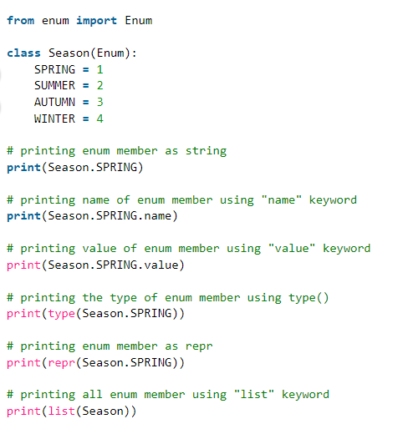
Python Enum Examples

Slide 19
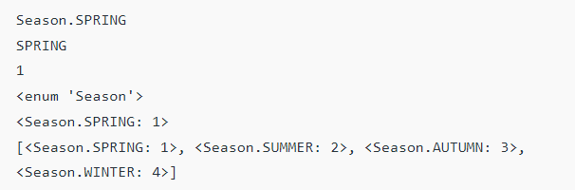
Python Enum Examples

Slide 20
Accessing Modes
Enum members can be accessed in two ways:
By value:- In this method, the value of enum member is passed.
By name:- In this method, the name of the enum member is passed.

Slide 21
Python Enum Examples
from enum import Enum
class Season(Enum):
SPRING = 1
SUMMER = 2
AUTUMN = 3
WINTER = 4
# Accessing enum member using value
print("The enum member associated with value 2 is : ", Season(2).name)
# Accessing enum member using name
print("The enum member associated with name AUTUMN is : ", Season['AUTUMN'].value)

Slide 22

Python Enum Examples
from enum import Enum
class Season(Enum):
SPRING = 1
SUMMER = 2
AUTUMN = 3
WINTER = 4
# Accessing enum member using value
print("The enum member associated with value 2 is : ", Season(2).name)
# Accessing enum member using name
print("The enum member associated with name AUTUMN is : ", Season['AUTUMN'].value)

Slide 23
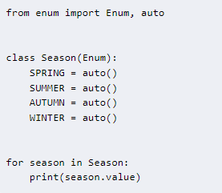
Python enum automatic values & iteration

Slide 24

Python enum automatic values

Slide 25
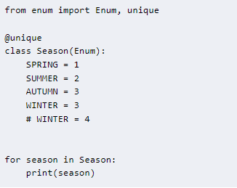
Python enum unique member values

Slide 26
Python enum unique member values
Gives Error!

Slide 27
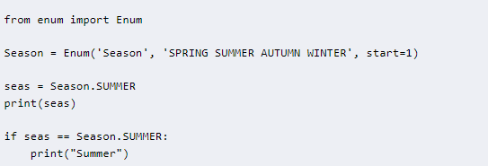
Python enum functional creation
Python enums can be created with functional API.

Slide 28
Advantages of Enums
Ease of maintenance: Enums centralize the definition of name values which makes it easier to upgrade or extend the set of values as per our requirements.
Readability and Self-Documentation: Enums provide meaningful names to values, making the code more human-readable and self-explanatory.
Type safety: Enums provide some level of type safety, ensuring that only valid values can be used.
Reduced risk of errors: Enums help prevent the use of incorrect or inconsistent values in your code, reducing the risk of bugs and errors.

